Slide 1
What Are Control Statements?
Control statements = traffic lights of programming
They decide the flow of your program
Types:
Conditional Statements → if, else, switch
Looping Statements → for, while, do-while
Jump Statements → break, continue, return
Analogy: Think of cooking in a kitchen – you decide (if), repeat stirring (loop), or stop cooking (break).

Slide 2
Conditional Statements
if-else: Makes decisions
switch: Menu of choices (like choosing a meal at a café)
Syntax is similar in Java and Python (Python uses indentation, Java uses braces).

Slide 3
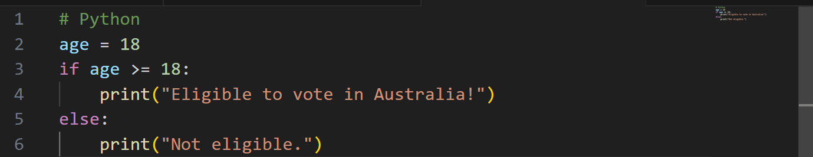
If-Else Example: Voting Eligibility in Python
1. Variable: A variable called age is created.
It is given the value 18.
In Python, you don’t need to write the type (int like in Java). Python figures it out automatically.

Slide 4
If-Else Example: Voting Eligibility in Python
2. If-else condition: if age >= 18:
Checks if age is greater than or equal to 18.
If true, it runs the code under this block → prints: Eligible to vote in Australia!

Slide 5
If-Else Example: Voting Eligibility in Python
else:
Runs only if the if condition is false.
Prints: Not eligible.

Slide 6
If-Else Example: Voting Eligibility in Python
3. Indentation
In Python, indentation (spaces at the beginning of the line) is very important.
The print(...) lines must be indented under if or else.

Slide 7
If-Else Example: Voting Eligibility in Python
Program Flow
Start at the top.
Store age = 18.
Check if age >= 18.
Since 18 is equal to 18 → condition is true.
Output

Slide 8
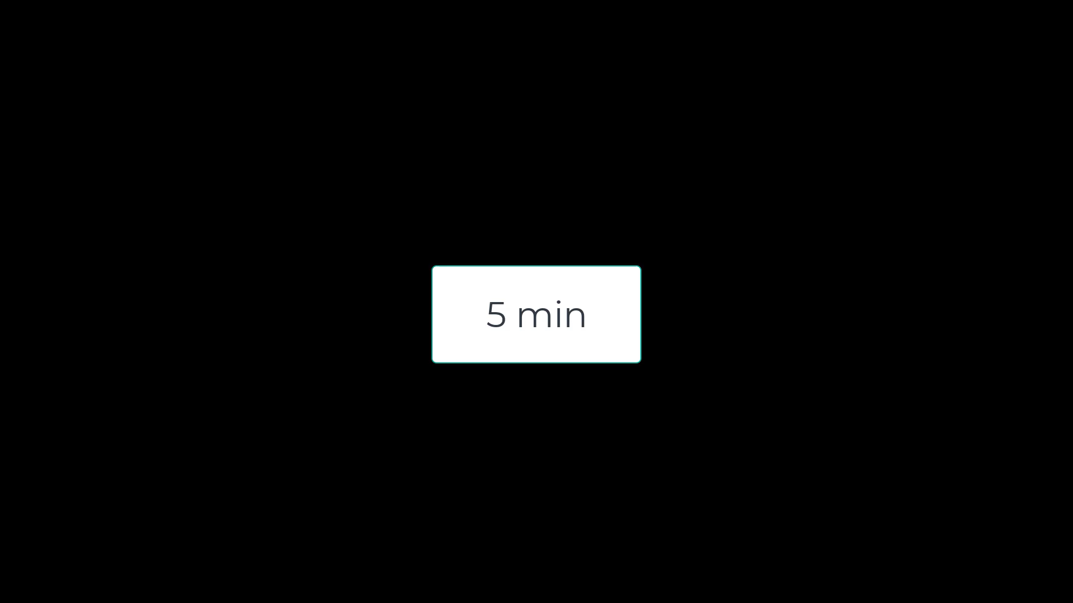
Activity 1: Try Different Ages
Task: Change the value of age and run the program. Test with at least three different ages:
Below 18 (e.g., 15)
Exactly 18
Above 18 (e.g., 25)
Goal: Students see how the program reacts differently for each case.

Slide 9
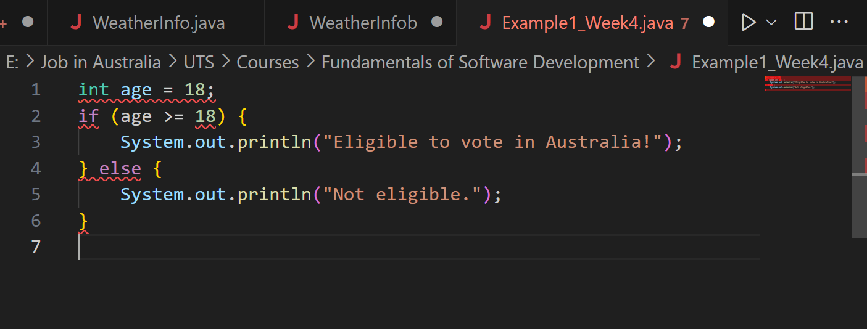
If-Else Example: Voting Eligibility in Java
Error: Main method not found in the file, please define the main method...
This is happening because Java needs a main method as the entry point of our program. Our code only has an if statement without wrapping it inside a class and a main method.

Slide 10
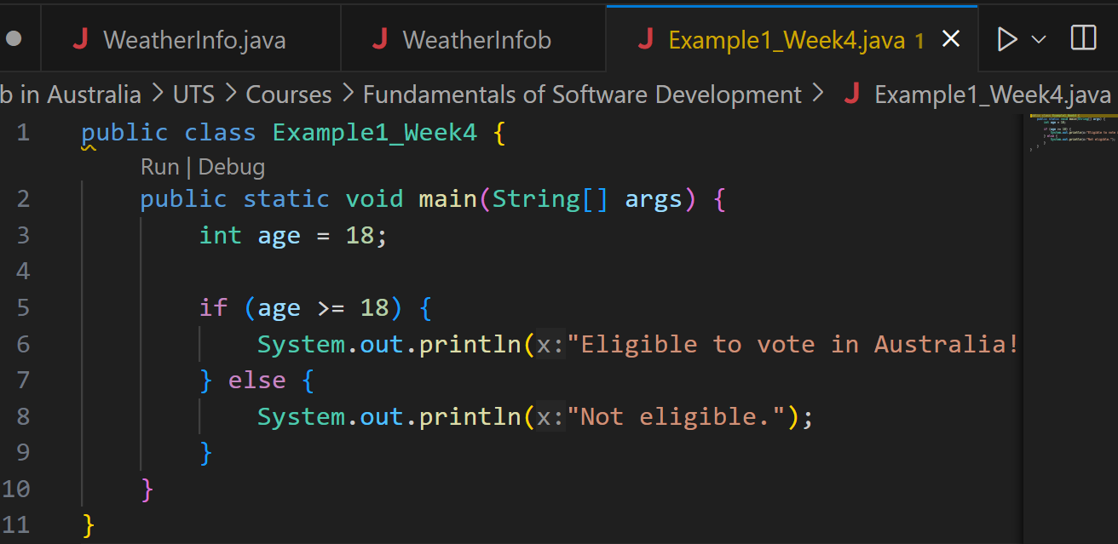
If-Else Example: Voting Eligibility in Java
1. Class: In Java, all code must be inside a class.
The class name (Example1_Week4) must match the file name (Example1_Week4.java).

Slide 11
If-Else Example: Voting Eligibility in Java
2. Main Method: This is the entry point of any Java program.
When you click Run, Java looks for this method to start the program.
String[] args allows input from the command line (not used here, but required).

Slide 12
If-Else Example: Voting Eligibility in Java
3. Variable: A variable named age is created and given the value 18.
int means it’s a whole number (integer).

Slide 13
If-Else Example: Voting Eligibility in Java
4. If-else condition: if checks the condition (age >= 18).
If true → print "Eligible to vote in Australia!".
If false → print "Not eligible.".

Slide 14
If-Else Example: Voting Eligibility in Java
5. Closing braces:
Close the main method, then close the class.

Slide 15
If-Else Example: Voting Eligibility in Java
Program Flow: Start at main.
Store age = 18.
Check if age is 18 or more.
Since it is, print:

Slide 16
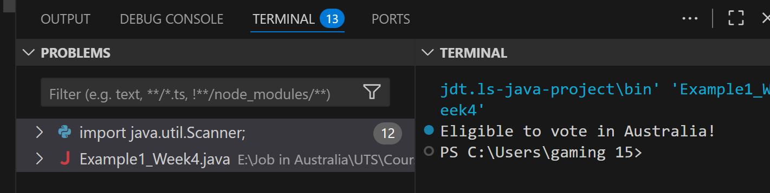
If-Else Example: Voting Eligibility in Java

Slide 17
Activity 2: Add a Second Condition
Task: Modify the if–else to include a new condition:
Age < 18 → "Not eligible."
Age between 18 and 70 → "Eligible to vote in Australia!"
Age > 70 → "Optional voting in Australia."
Goal: Students practice adding conditions (else if) and understand how real-world rules can be modeled in code.

Slide 18
Looping Statements
Repeat tasks until a condition is met
for loop → like counting seats in a lecture hall
while loop → keep walking until the bus arrives
do-while loop (Java only) → at least one attempt (like trying your Opal card tap even if balance is low)

Slide 19
Jump Statements
break → leave the loop early (like leaving a class early if fire alarm rings )
continue → skip one step, move to next (like skipping one stop while driving Uber Eats)
return → exit from the method completely

Slide 20
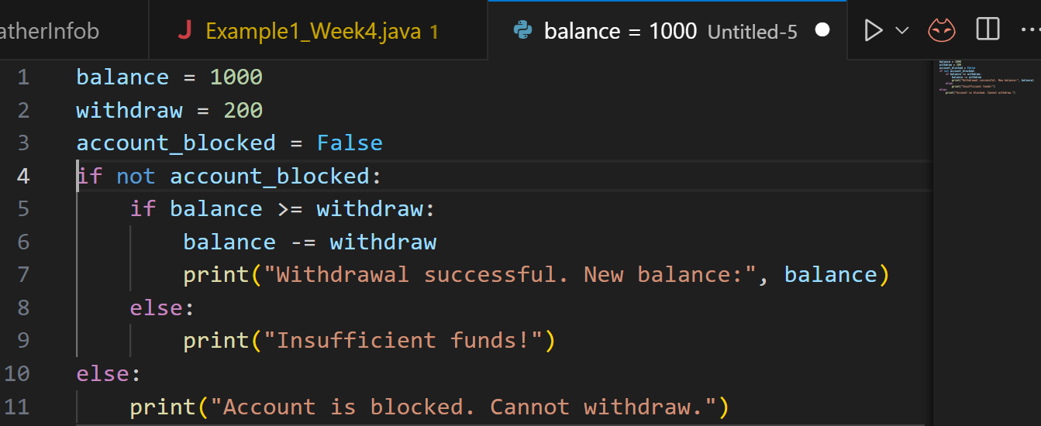
Bank Case Study (Link to Lab 4)
Step 1: Simple example: The following code simulates a simple banking withdrawal:
balance = 1000 → account starts with $1000.
withdraw = 200 → trying to withdraw $200.
account_blocked = False → account is active.

Slide 21
Bank Case Study (Link to Lab 4)
If the account is not blocked, then:
If balance ≥ withdrawal → deduct money and show new balance.
Else → show “Insufficient funds!”
If the account is blocked, print a warning.

Slide 22
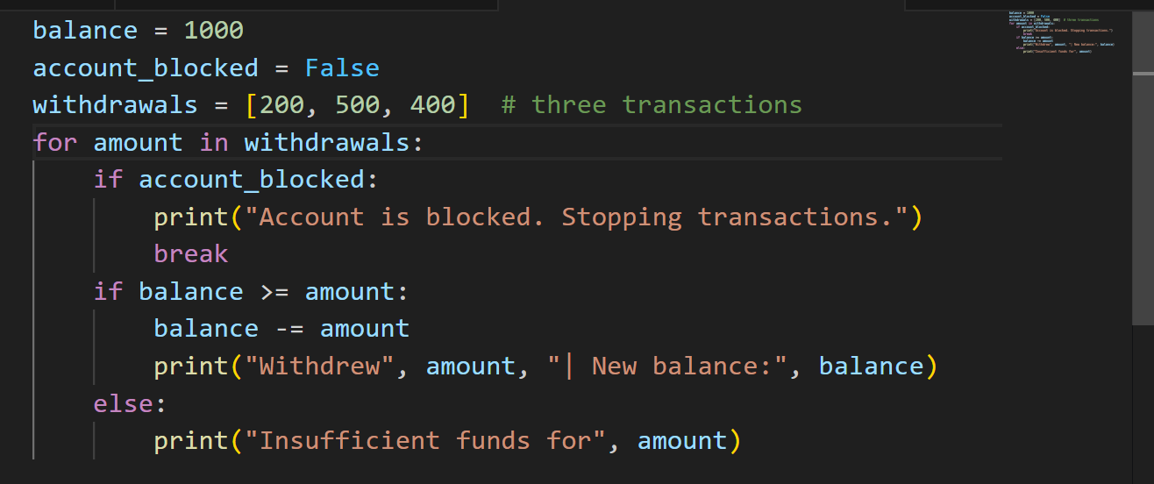
Bank Case Study (Link to Lab 4)
Program goes through each withdrawal in the list.
If the account is blocked → it stops immediately (break).
Otherwise, it checks balance before withdrawing.
Step 2: Add Loop for Multiple Transactions

Slide 23
Activity 3: Try Different Transactions
Change the withdrawals list to [100, 300, 700].
Observe how the program responds when balance is not enough.
Goal: Students see how conditions work for different inputs.

Slide 24
Activity 4: Simulate a Blocked Account
Set account_blocked = True.
Run the program.
What happens?
Goal: Students see how break stops the loop immediately when account is blocked.

Slide 25
Learning Reinforcement (2 min)
Research Discussion Questions
1. Why are control statements compared to "decision-making" in real life?
Because they decide what happens next in a program just like we decide based on conditions (e.g., weather → carry umbrella or not).
2. Which control statement is most used in real-world apps in Australia (e.g., MyGov, Opal card, online banking)?
Mostly conditional checks (eligibility, balance, login).

Slide 26
Activities 5 and 6
Activity 1 (Java): Write a program that checks if a customer is eligible for a student Opal card (age < 25).
Activity 2 (Python): Write a loop to display numbers from 1–10, but skip 5 using continue.

Slide 27
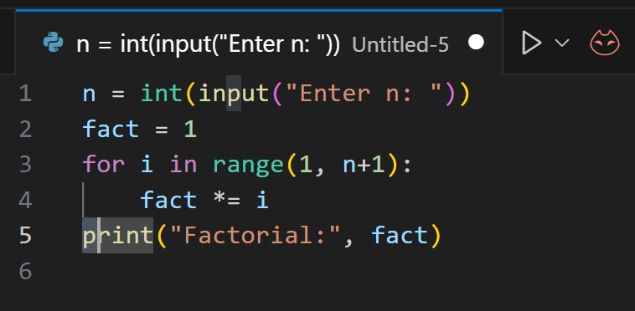
Problem-Solving Example (Factorial – Lab 4 Ex.8) - Python
Task: Write a program to calculate factorial of n (entered from keyboard).

Slide 28
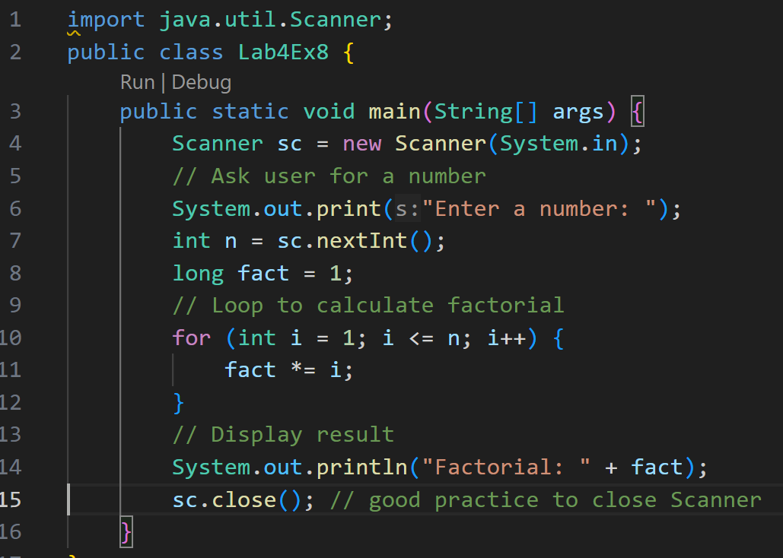
Problem-Solving Example (Factorial – Lab 4 Ex.8) - Java
Task: Write a program to calculate factorial of n (entered from keyboard).
1. Import Scanner: Scanner is used to take input from the user (like typing a number in the console).

Slide 29
Problem-Solving Example (Factorial – Lab 4 Ex.8) - Java
Task: Write a program to calculate factorial of n (entered from keyboard).
2. Class and Main Method: Every Java program must have a class.
The main method is where the program starts running.

Slide 30
Problem-Solving Example (Factorial – Lab 4 Ex.8) - Java
Task: Write a program to calculate factorial of n (entered from keyboard).
3. Create Scanner Object: Creates a Scanner to read input from the keyboard.

Slide 31
Problem-Solving Example (Factorial – Lab 4 Ex.8) - Java
Task: Write a program to calculate factorial of n (entered from keyboard).
4. Ask User for a Number: Program asks: "Enter a number:"
Whatever the user types is stored in variable n.

Slide 32
Problem-Solving Example (Factorial – Lab 4 Ex.8) - Java
Task: Write a program to calculate factorial of n (entered from keyboard).
5. Factorial Logic:
fact starts as 1.
The for loop multiplies numbers from 1 to n.
Example: if n = 5 → fact = 1 × 2 × 3 × 4 × 5 = 120.

Slide 33
Problem-Solving Example (Factorial – Lab 4 Ex.8) - Java
Task: Write a program to calculate factorial of n (entered from keyboard).
6. Print Results:
System.out.println("Factorial: " + fact);

Slide 34
Problem-Solving Example (Factorial – Lab 4 Ex.8) - Java
Task: Write a program to calculate factorial of n (entered from keyboard).
7. Close Scanner:
Closes the Scanner (good practice to free resources).

Slide 35
Problem-Solving Example (Factorial – Lab 4 Ex.8) - Java
Task: Write a program to calculate factorial of n (entered from keyboard).
User enters a number (e.g., 5).
Program multiplies numbers from 1 to n.
1 × 2 × 3 × 4 × 5 = 120.
Prints: 120

Slide 36
Activity 7
Modify factorial program to reject negative numbers.
Add condition: If n > 20, display “Too large to calculate” and exit.

Slide 37
Role-Playing Debate Questions (2 min)
Debate 1: Should programmers always prefer for loops over while loops?
No, for is good for known ranges; while fits unknown conditions.
Debate 2: Is break a bad practice because it makes logic less clear?
Depends – in banking/security apps, sometimes it simplifies code, but overuse makes code hard to read.

Slide 38

Happy Learning and Bright Futures Ahead! Dr. Farshid Keivanian Stay Connected: linkedin.com/in/farshid-keivanian github.com/FarshidKeivanian
Education is the most powerful weapon you can use to change the world. — Nelson Mandela

